Slide 1



INTRODUCTION TO LLMs
Brian Lynch

Slide 2

AGENDA
What are LLMs?
Environment setup
Preprocessing
Project kick-off
Notes:
In this lecture we’ll first talk broadly about how data is being accessed when we use SQL, then we’ll go into detail about how to join tables together using the JOIN command. After going through the lecture slides we’ll jump over to pgAdmin and run through some demos.

Slide 3
What are LLMs?
Notes:
So, let’s start off by talking about accessing data using SQL.

Slide 4
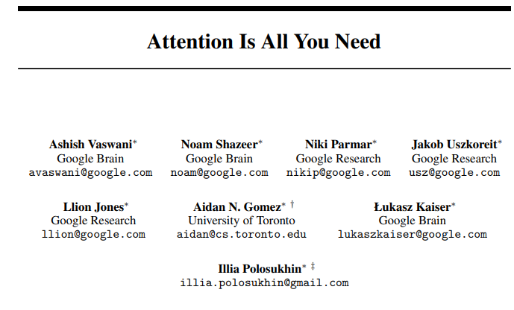
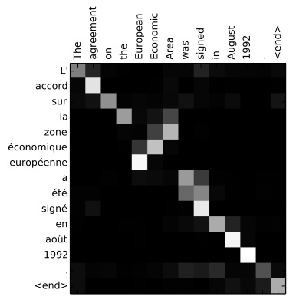
WHAT ARE LLMs?
Large language models (LLMs) are the current state-of-the-art in natural language processing (NLP).
They are based on a neural network architecture that solves many of the problems of previous NLP machine learning algorithms.
Based on the concept of attention – analyzing each word with specific weight on other words.
Large language model: trained on enormous amounts of data
ChatGPT: trained on 570GB of text data with 300 billion words
https://arxiv.org/pdf/1706.03762.pdf
https://www.comet.com/site/blog/explainable-ai-for-transformers/
Notes:
When we talk about accessing data the first thing we need to keep in mind is how the data is stored in the first place. There are many different file types and folder structures for how we might actually store data digitally. But, more importantly, we should consider where those files are stored: on your computer, on another computer or server on your local network, on a remote server connected over the internet, or remotely over the cloud. What’s the difference between a remote server and the cloud? Cloud data storage tends to be spread across multiple servers to ensure redundancy, among other differences.
With SQL, we use a particular software platform to interact with the data files through particular communication protocols such as TCP and then present them to a user within a database structure. There are quite a few different platforms out there including the ones you can see here, and note that there are different flavours of SQL used by each platform. For this boot camp we’ll be using PostgreSQL as the language and pgAdmin as the software platform.

Slide 5
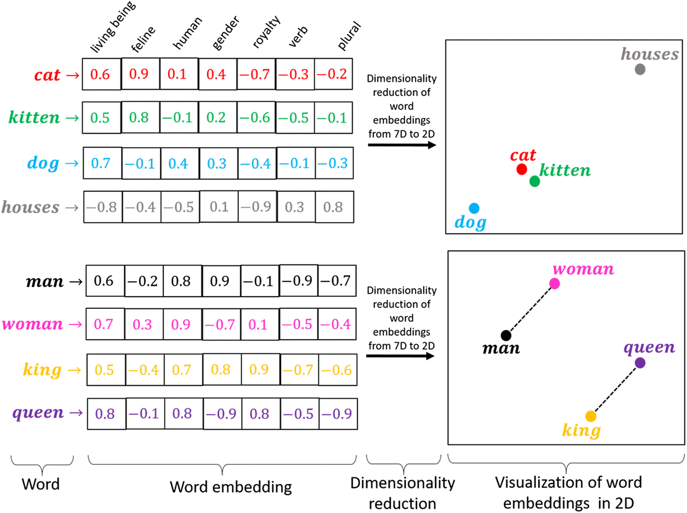
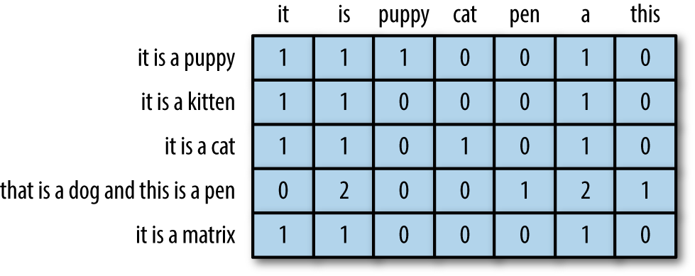
EVOLUTION OF NLP
Captures meaning but no word ordering or context
Bag of words: separate each document (sentence, email, paragraph, article, etc.) into individual words and count their frequencies
Word embedding: neural network model that generates vectors representing each word in a higher dimensional space where words with similar meanings are closer to each other.
Converts text data to numerical values but too simplistic, no word order, no meaning
https://ucdavisdatalab.github.io/workshop-nlp-healthcare/working-with-text-data-in-r.html
https://www.analyticsvidhya.com/blog/2021/07/feature-extraction-and-embeddings-in-nlp-a-beginners-guide-to-understand-natural-language-processing/
Notes:
When we talk about accessing data the first thing we need to keep in mind is how the data is stored in the first place. There are many different file types and folder structures for how we might actually store data digitally. But, more importantly, we should consider where those files are stored: on your computer, on another computer or server on your local network, on a remote server connected over the internet, or remotely over the cloud. What’s the difference between a remote server and the cloud? Cloud data storage tends to be spread across multiple servers to ensure redundancy, among other differences.
With SQL, we use a particular software platform to interact with the data files through particular communication protocols such as TCP and then present them to a user within a database structure. There are quite a few different platforms out there including the ones you can see here, and note that there are different flavours of SQL used by each platform. For this boot camp we’ll be using PostgreSQL as the language and pgAdmin as the software platform.

Slide 6
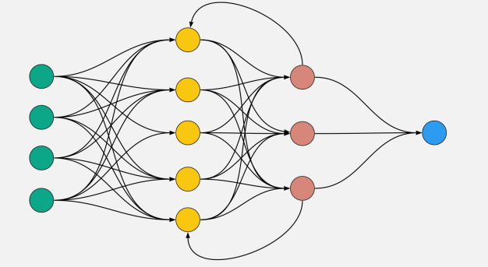
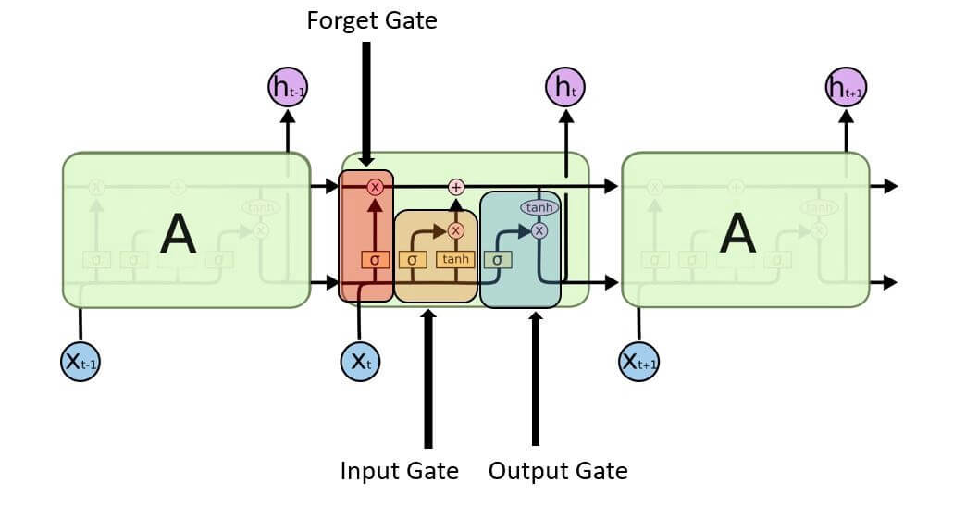
EVOLUTION OF NLP
Computationally complex, long training time and memory intensive
Recurrent neural networks (RNN): extends standard neural network architecture to account for order of inputs (i.e., order of words in a sentence for NLP RNNs).
Long short-term memory neural networks (LSTM): neural network model that accounts for order of inputs but also includes a persistent variable to pass information throughout the network for “longer”.
Captures importance of word order but only for words close together
https://www.analyticsvidhya.com/blog/2022/01/top-10-techniques-for-deep-learning-that-you-must-know/
https://www.javatpoint.com/long-short-term-memory-rnn-in-tensorflow
Notes:
When we talk about accessing data the first thing we need to keep in mind is how the data is stored in the first place. There are many different file types and folder structures for how we might actually store data digitally. But, more importantly, we should consider where those files are stored: on your computer, on another computer or server on your local network, on a remote server connected over the internet, or remotely over the cloud. What’s the difference between a remote server and the cloud? Cloud data storage tends to be spread across multiple servers to ensure redundancy, among other differences.
With SQL, we use a particular software platform to interact with the data files through particular communication protocols such as TCP and then present them to a user within a database structure. There are quite a few different platforms out there including the ones you can see here, and note that there are different flavours of SQL used by each platform. For this boot camp we’ll be using PostgreSQL as the language and pgAdmin as the software platform.

Slide 7
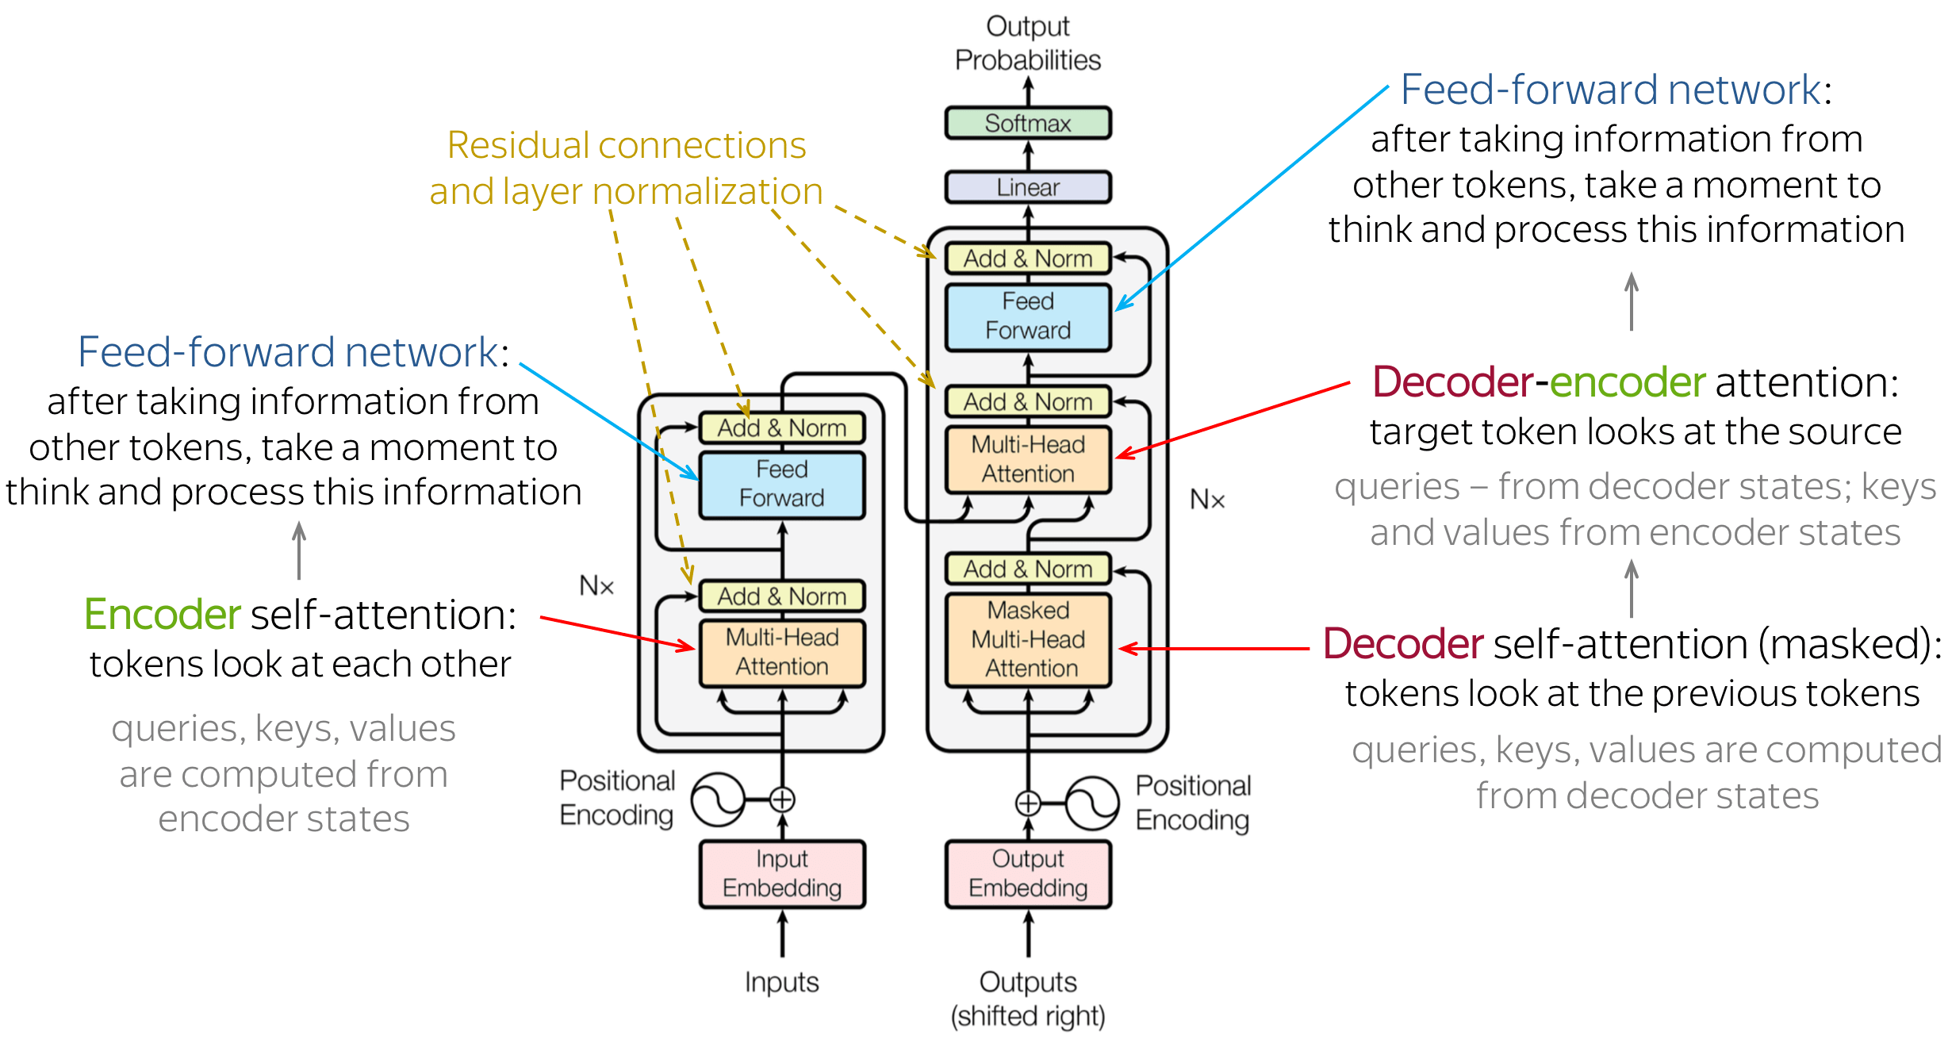
EVOLUTION OF NLP
Transformers: uses an attention mechanism to link words together more appropriately and provide better modelling for context and word order. No use of recurrence and therefore faster and lower on memory usage (can train with parallel processing more easily).
https://stats.stackexchange.com/questions/512242/why-does-transformer-has-such-a-complex-architecture
Notes:
When we talk about accessing data the first thing we need to keep in mind is how the data is stored in the first place. There are many different file types and folder structures for how we might actually store data digitally. But, more importantly, we should consider where those files are stored: on your computer, on another computer or server on your local network, on a remote server connected over the internet, or remotely over the cloud. What’s the difference between a remote server and the cloud? Cloud data storage tends to be spread across multiple servers to ensure redundancy, among other differences.
With SQL, we use a particular software platform to interact with the data files through particular communication protocols such as TCP and then present them to a user within a database structure. There are quite a few different platforms out there including the ones you can see here, and note that there are different flavours of SQL used by each platform. For this boot camp we’ll be using PostgreSQL as the language and pgAdmin as the software platform.

Slide 8
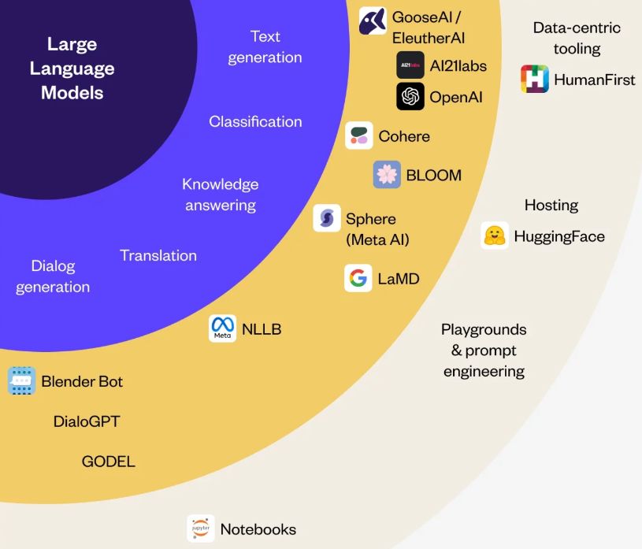
LARGE LANGUAGE MODELS
Large language models are trained on enormous sets of text data to enable general-purpose language understanding.
They can be applied to many types of NLP problems such as text generation, classification, sentiment analysis, translation, etc.
https://www.researchgate.net/figure/Autoregressive-sampling-The-LLM-is-sampled-to-generate-a-single-token-continuation-of_fig1_371123751
Notes:
When we talk about accessing data the first thing we need to keep in mind is how the data is stored in the first place. There are many different file types and folder structures for how we might actually store data digitally. But, more importantly, we should consider where those files are stored: on your computer, on another computer or server on your local network, on a remote server connected over the internet, or remotely over the cloud. What’s the difference between a remote server and the cloud? Cloud data storage tends to be spread across multiple servers to ensure redundancy, among other differences.
With SQL, we use a particular software platform to interact with the data files through particular communication protocols such as TCP and then present them to a user within a database structure. There are quite a few different platforms out there including the ones you can see here, and note that there are different flavours of SQL used by each platform. For this boot camp we’ll be using PostgreSQL as the language and pgAdmin as the software platform.

Slide 9
Environment setup
Notes:
Okay, let’s move on to talk in detail about joining data.

Slide 10
ENVIRONMENT SETUP
Python modules:
Name | Description
nltk | Set of simple NLP tools
spacy | Set of more complex NLP tools
gensim | Another set of more complex NLP tools
sklearn | General machine learning tools (some NLP)
transformers | Transformer tools
pytorch | Deep learning tools
tensorflow | Deep learning tools
Notes:
When we talk about accessing data the first thing we need to keep in mind is how the data is stored in the first place. There are many different file types and folder structures for how we might actually store data digitally. But, more importantly, we should consider where those files are stored: on your computer, on another computer or server on your local network, on a remote server connected over the internet, or remotely over the cloud. What’s the difference between a remote server and the cloud? Cloud data storage tends to be spread across multiple servers to ensure redundancy, among other differences.
With SQL, we use a particular software platform to interact with the data files through particular communication protocols such as TCP and then present them to a user within a database structure. There are quite a few different platforms out there including the ones you can see here, and note that there are different flavours of SQL used by each platform. For this boot camp we’ll be using PostgreSQL as the language and pgAdmin as the software platform.

Slide 11

ENVIRONMENT SETUP
Although we can do some basic NLP analyses using a standard computer, a lot of the latest state-of-the-art algorithms require more heavy processing with GPUs.
You are of course free to try running these types of algorithms on your own computer, but we can make use of Google Colab where we run notebooks online and processing with GPU resources made available to the public (with limits).
Notes:
When we talk about accessing data the first thing we need to keep in mind is how the data is stored in the first place. There are many different file types and folder structures for how we might actually store data digitally. But, more importantly, we should consider where those files are stored: on your computer, on another computer or server on your local network, on a remote server connected over the internet, or remotely over the cloud. What’s the difference between a remote server and the cloud? Cloud data storage tends to be spread across multiple servers to ensure redundancy, among other differences.
With SQL, we use a particular software platform to interact with the data files through particular communication protocols such as TCP and then present them to a user within a database structure. There are quite a few different platforms out there including the ones you can see here, and note that there are different flavours of SQL used by each platform. For this boot camp we’ll be using PostgreSQL as the language and pgAdmin as the software platform.

Slide 12
Preprocessing
Notes:
Okay, let’s move on to talk in detail about joining data.

Slide 13
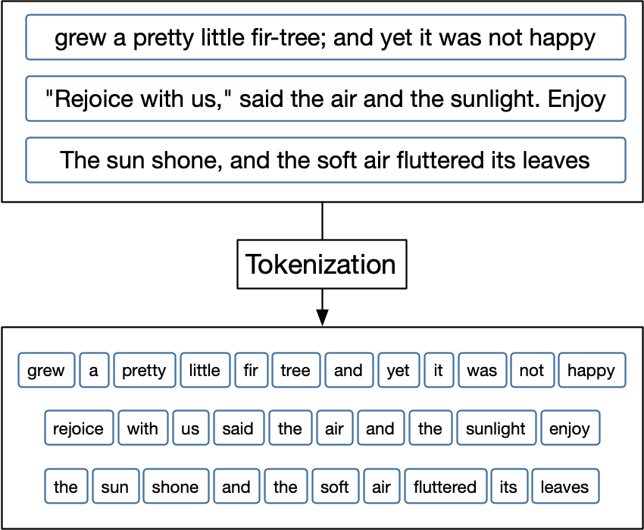
PREPROCESSING
Text data cannot simply be processed as strings and characters – we need to convert it to a numerical representation.
The way we do this is to consider words, parts of words, or combinations of multiple words as tokens.
Tokenizing our raw text data is done through a series of preprocessing steps.
https://smltar.com/tokenization.html
Notes:
When we talk about accessing data the first thing we need to keep in mind is how the data is stored in the first place. There are many different file types and folder structures for how we might actually store data digitally. But, more importantly, we should consider where those files are stored: on your computer, on another computer or server on your local network, on a remote server connected over the internet, or remotely over the cloud. What’s the difference between a remote server and the cloud? Cloud data storage tends to be spread across multiple servers to ensure redundancy, among other differences.
With SQL, we use a particular software platform to interact with the data files through particular communication protocols such as TCP and then present them to a user within a database structure. There are quite a few different platforms out there including the ones you can see here, and note that there are different flavours of SQL used by each platform. For this boot camp we’ll be using PostgreSQL as the language and pgAdmin as the software platform.

Slide 14
PREPROCESSING
The dog was running down the street when the mailman yelled “Help me!”.
We typically apply a series of steps to tokenize:
the dog was running down the street when the mailman yelled “help me!”.
Convert all letters to lowercase
Remove punctuation
Separate string into list of strings (words)
Stemming/lemmatization to convert word to its root
Remove unnecessary/non-useful “stop words”
the dog was running down the street when the mailman yelled help me
[the, dog, was, running, down, the, street, when, the, mailman, yelled, help, me]
[the, dog, was, run, down, the, street, when, the, mailman, yell, help, me]
[dog, run, down, street, mailman, yell, help, me]
Notes:
When we talk about accessing data the first thing we need to keep in mind is how the data is stored in the first place. There are many different file types and folder structures for how we might actually store data digitally. But, more importantly, we should consider where those files are stored: on your computer, on another computer or server on your local network, on a remote server connected over the internet, or remotely over the cloud. What’s the difference between a remote server and the cloud? Cloud data storage tends to be spread across multiple servers to ensure redundancy, among other differences.
With SQL, we use a particular software platform to interact with the data files through particular communication protocols such as TCP and then present them to a user within a database structure. There are quite a few different platforms out there including the ones you can see here, and note that there are different flavours of SQL used by each platform. For this boot camp we’ll be using PostgreSQL as the language and pgAdmin as the software platform.

Slide 15
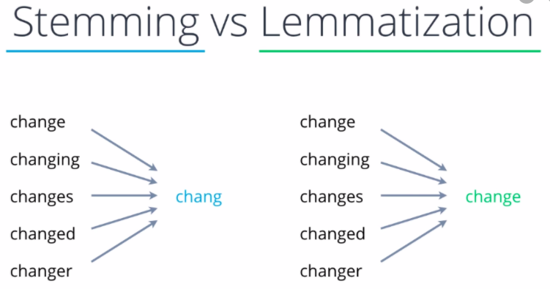
PREPROCESSING
Notes:
When we talk about accessing data the first thing we need to keep in mind is how the data is stored in the first place. There are many different file types and folder structures for how we might actually store data digitally. But, more importantly, we should consider where those files are stored: on your computer, on another computer or server on your local network, on a remote server connected over the internet, or remotely over the cloud. What’s the difference between a remote server and the cloud? Cloud data storage tends to be spread across multiple servers to ensure redundancy, among other differences.
With SQL, we use a particular software platform to interact with the data files through particular communication protocols such as TCP and then present them to a user within a database structure. There are quite a few different platforms out there including the ones you can see here, and note that there are different flavours of SQL used by each platform. For this boot camp we’ll be using PostgreSQL as the language and pgAdmin as the software platform.

Slide 16
PREPROCESSING
Once we have a list of tokens for each “document” (e.g., sentence, email, tweet, article) we can then convert to a bag-of-words representation.
Now we have a set of word counts where each row is a document and each column is a word in our overall vocabulary across all documents.
Note this will typically be very sparse (lots of zeroes).
Notes:
When we talk about accessing data the first thing we need to keep in mind is how the data is stored in the first place. There are many different file types and folder structures for how we might actually store data digitally. But, more importantly, we should consider where those files are stored: on your computer, on another computer or server on your local network, on a remote server connected over the internet, or remotely over the cloud. What’s the difference between a remote server and the cloud? Cloud data storage tends to be spread across multiple servers to ensure redundancy, among other differences.
With SQL, we use a particular software platform to interact with the data files through particular communication protocols such as TCP and then present them to a user within a database structure. There are quite a few different platforms out there including the ones you can see here, and note that there are different flavours of SQL used by each platform. For this boot camp we’ll be using PostgreSQL as the language and pgAdmin as the software platform.

Slide 17
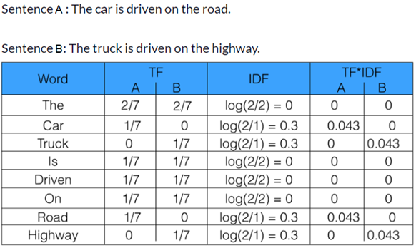
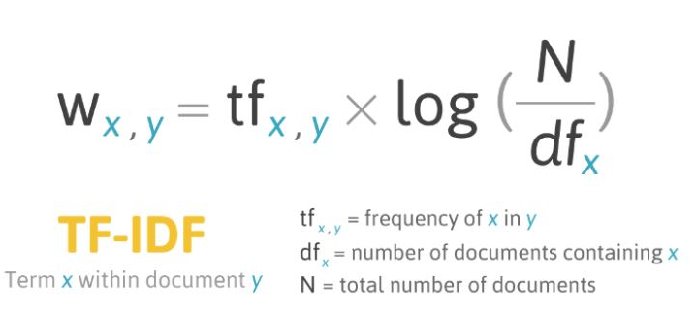
PREPROCESSING
We can also use what is called term frequency inverse document frequency, which is computed from our word counts but considers words that appear frequently across all documents to be less important.
Notes:
When we talk about accessing data the first thing we need to keep in mind is how the data is stored in the first place. There are many different file types and folder structures for how we might actually store data digitally. But, more importantly, we should consider where those files are stored: on your computer, on another computer or server on your local network, on a remote server connected over the internet, or remotely over the cloud. What’s the difference between a remote server and the cloud? Cloud data storage tends to be spread across multiple servers to ensure redundancy, among other differences.
With SQL, we use a particular software platform to interact with the data files through particular communication protocols such as TCP and then present them to a user within a database structure. There are quite a few different platforms out there including the ones you can see here, and note that there are different flavours of SQL used by each platform. For this boot camp we’ll be using PostgreSQL as the language and pgAdmin as the software platform.

Slide 18
PREPROCESSING
We can also apply a neural network model to create word embeddings that encode words as high-dimensional vectors across dimensions that represent meaning.
This typically involves using a pre-trained model (e.g., word2vec)
Notes:
When we talk about accessing data the first thing we need to keep in mind is how the data is stored in the first place. There are many different file types and folder structures for how we might actually store data digitally. But, more importantly, we should consider where those files are stored: on your computer, on another computer or server on your local network, on a remote server connected over the internet, or remotely over the cloud. What’s the difference between a remote server and the cloud? Cloud data storage tends to be spread across multiple servers to ensure redundancy, among other differences.
With SQL, we use a particular software platform to interact with the data files through particular communication protocols such as TCP and then present them to a user within a database structure. There are quite a few different platforms out there including the ones you can see here, and note that there are different flavours of SQL used by each platform. For this boot camp we’ll be using PostgreSQL as the language and pgAdmin as the software platform.

Slide 19
EXAMPLE COLAB NOTEBOOK
Google Colab example:
https://colab.research.google.com/drive/1MwgorhzFSqP7xuc6OZoa50b_5Lk5yCzF?usp=sharing
Notes:
When we talk about accessing data the first thing we need to keep in mind is how the data is stored in the first place. There are many different file types and folder structures for how we might actually store data digitally. But, more importantly, we should consider where those files are stored: on your computer, on another computer or server on your local network, on a remote server connected over the internet, or remotely over the cloud. What’s the difference between a remote server and the cloud? Cloud data storage tends to be spread across multiple servers to ensure redundancy, among other differences.
With SQL, we use a particular software platform to interact with the data files through particular communication protocols such as TCP and then present them to a user within a database structure. There are quite a few different platforms out there including the ones you can see here, and note that there are different flavours of SQL used by each platform. For this boot camp we’ll be using PostgreSQL as the language and pgAdmin as the software platform.

Slide 20
Review Preprocessing Activity
Notes:
Okay, let’s move on to talk in detail about joining data.

Slide 21
LLM Project Kick-Off
Notes:
Okay, let’s move on to talk in detail about joining data.

